Slide 1
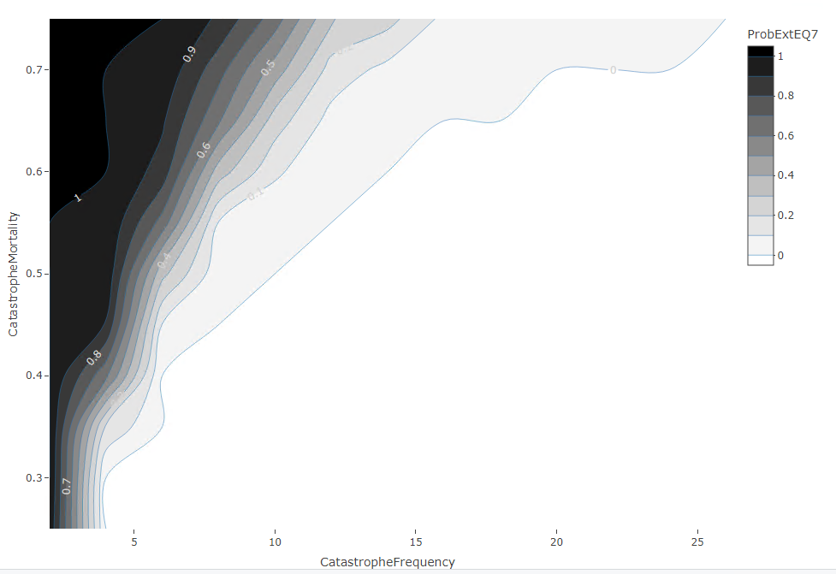
Catastrophe, 200sims, fine grid , non-IBM Recruit

Slide 2
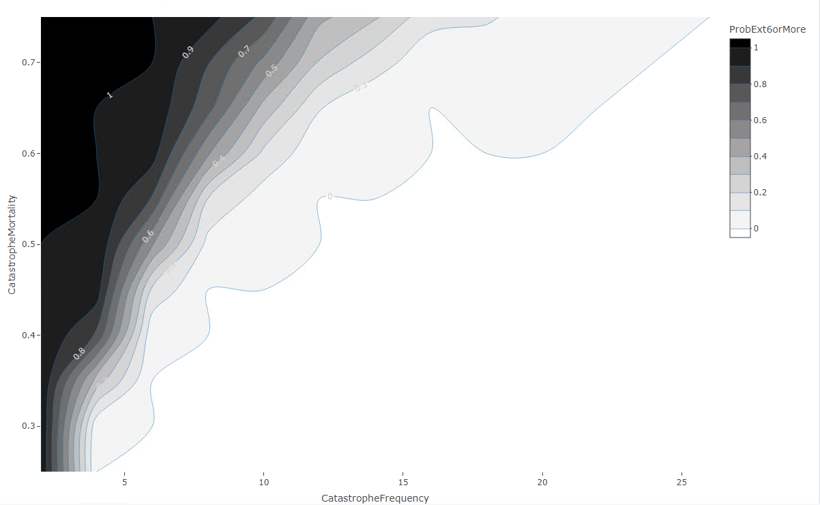
Catastrophe, 200sims, fine grid , non-IBM Recruit

Slide 3
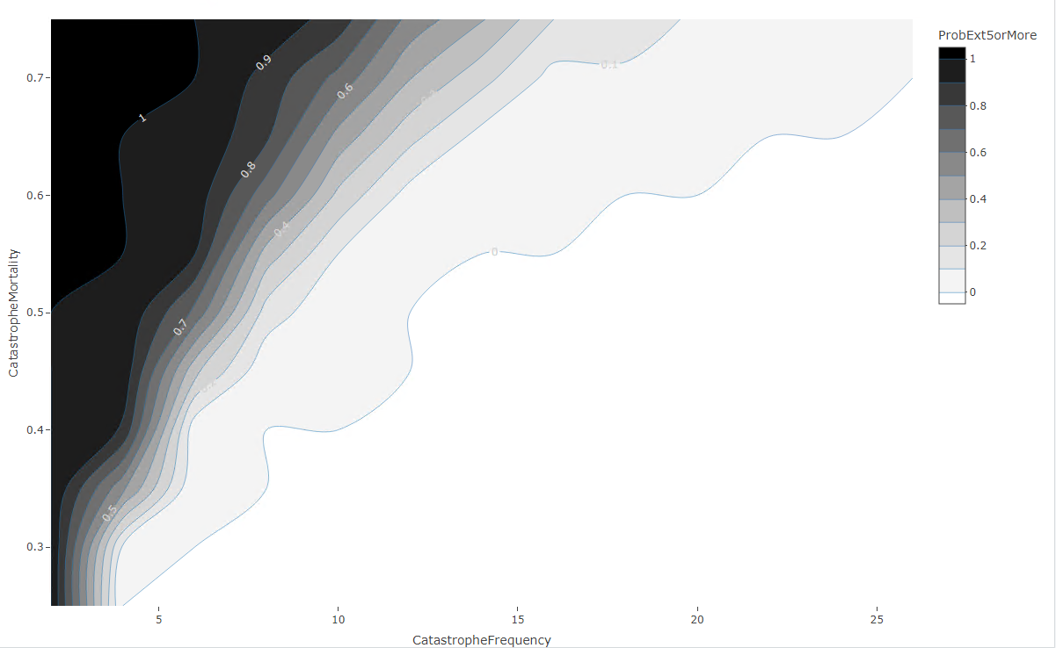
Catastrophe, 200sims, fine grid , non-IBM Recruit

Slide 4
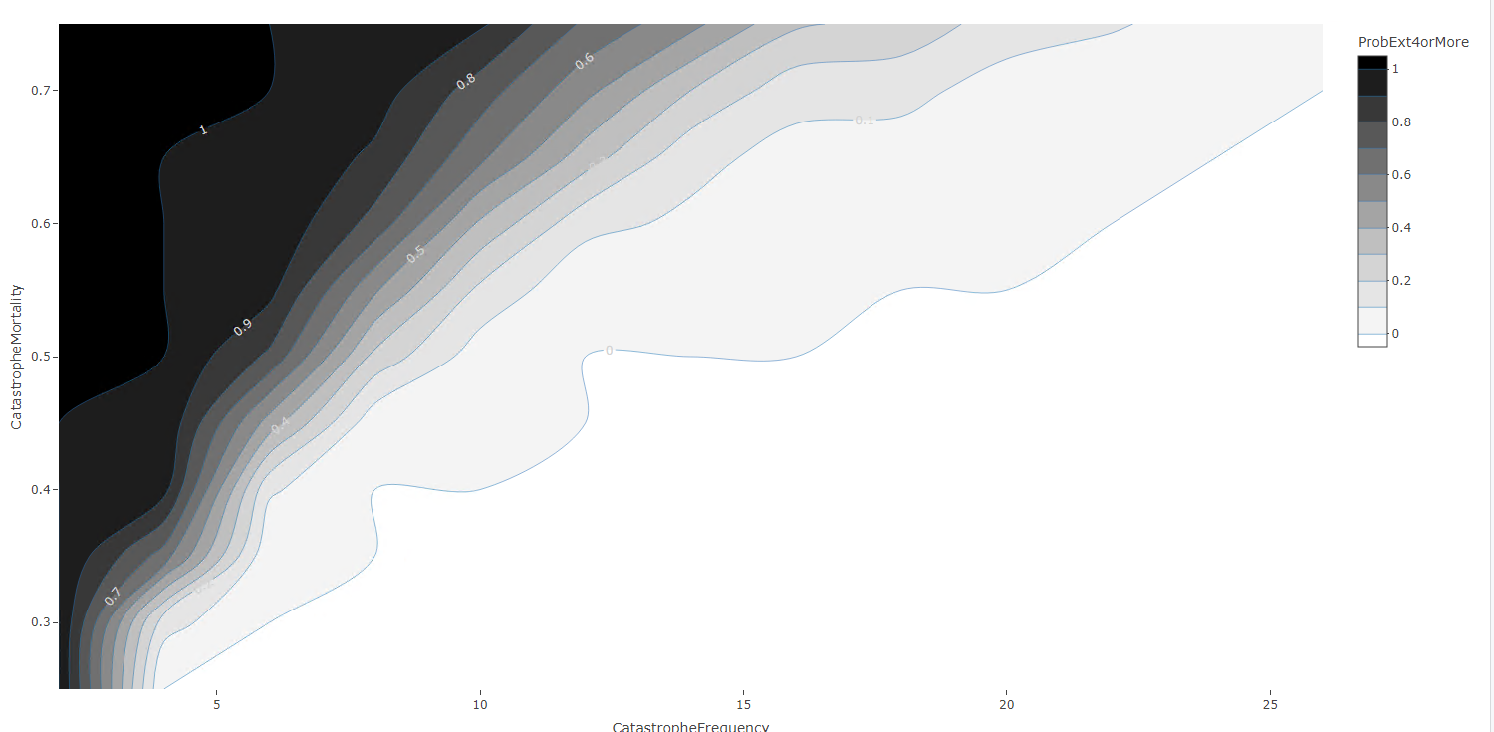
Catastrophe, 200sims, fine grid , non-IBM Recruit

Slide 5
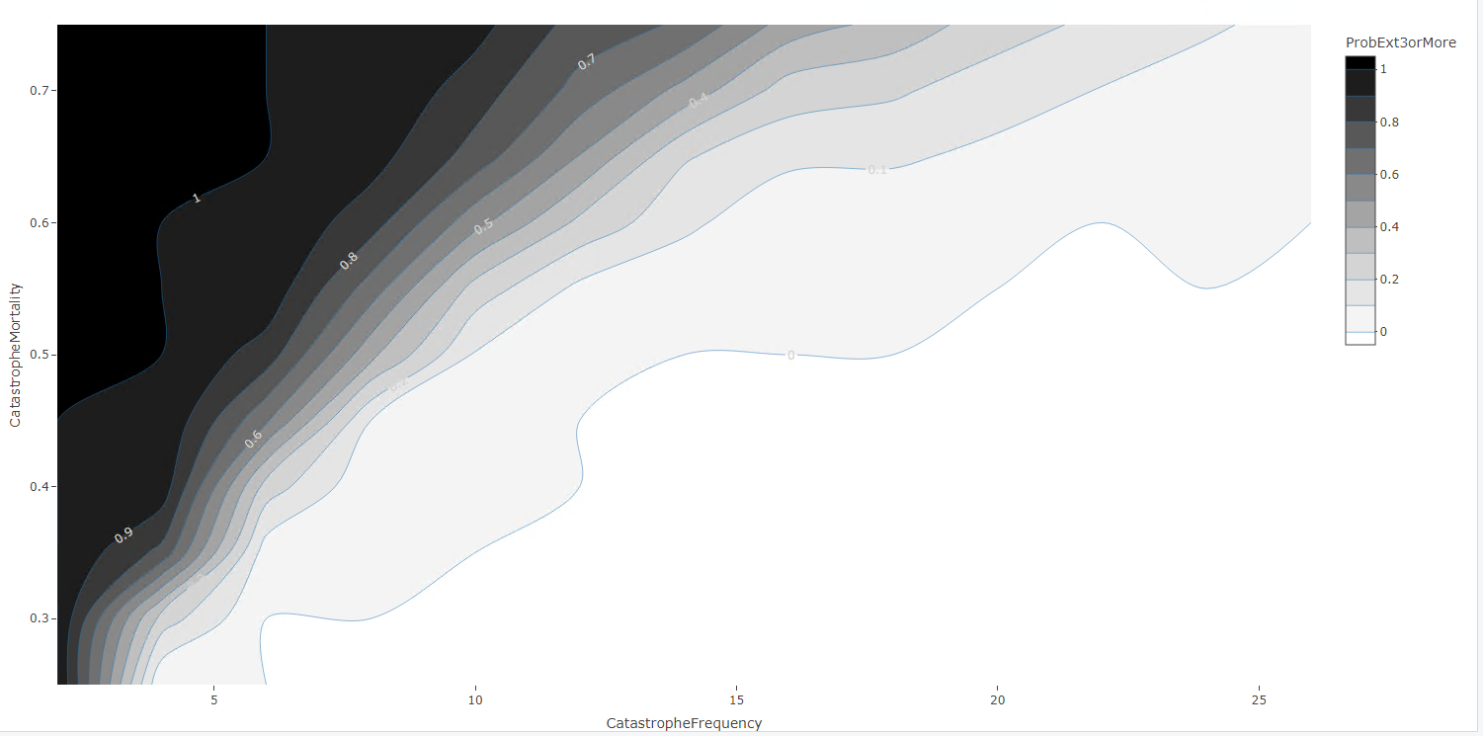
Catastrophe, 200sims, fine grid , non-IBM Recruit

Slide 6
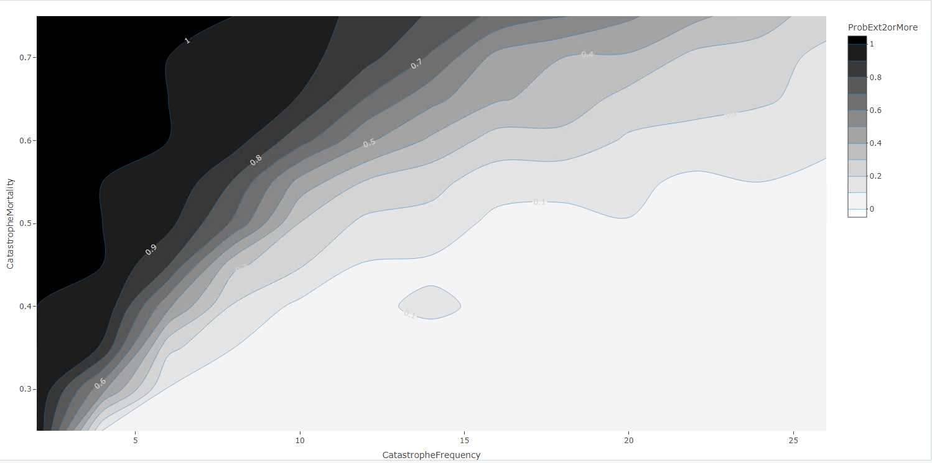
Catastrophe, 200sims, fine grid , non-IBM Recruit

Slide 7
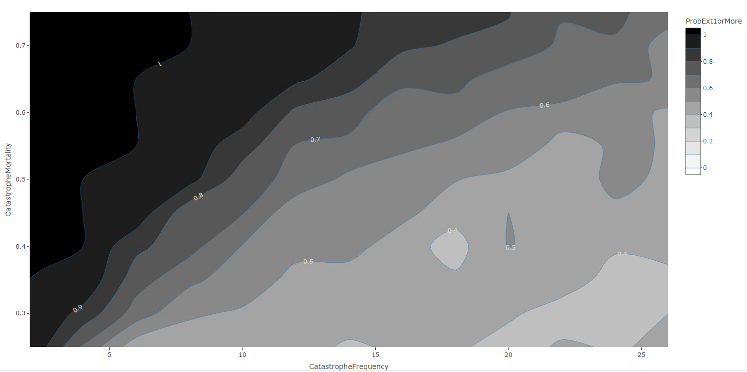
Catastrophe, 200sims, fine grid , non-IBM Recruit

Slide 8
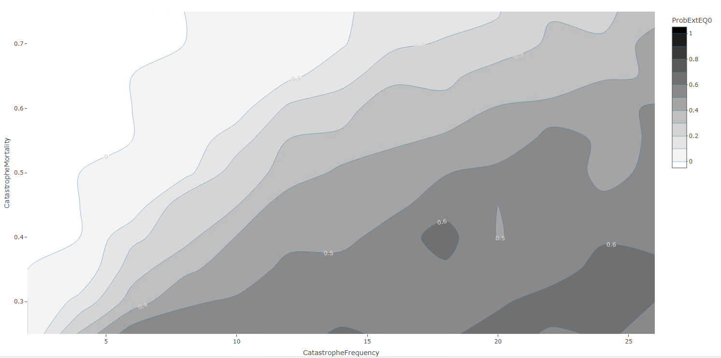
Catastrophe, 200sims, fine grid, non-IBM Recruit

Slide 9
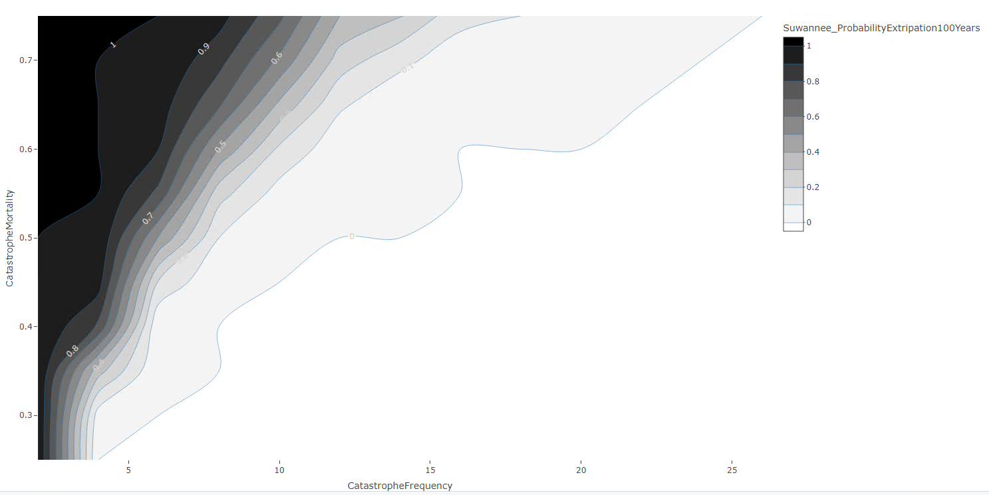
Catastrophe, 200sims, fine grid, non-IBM Recruit

Slide 10
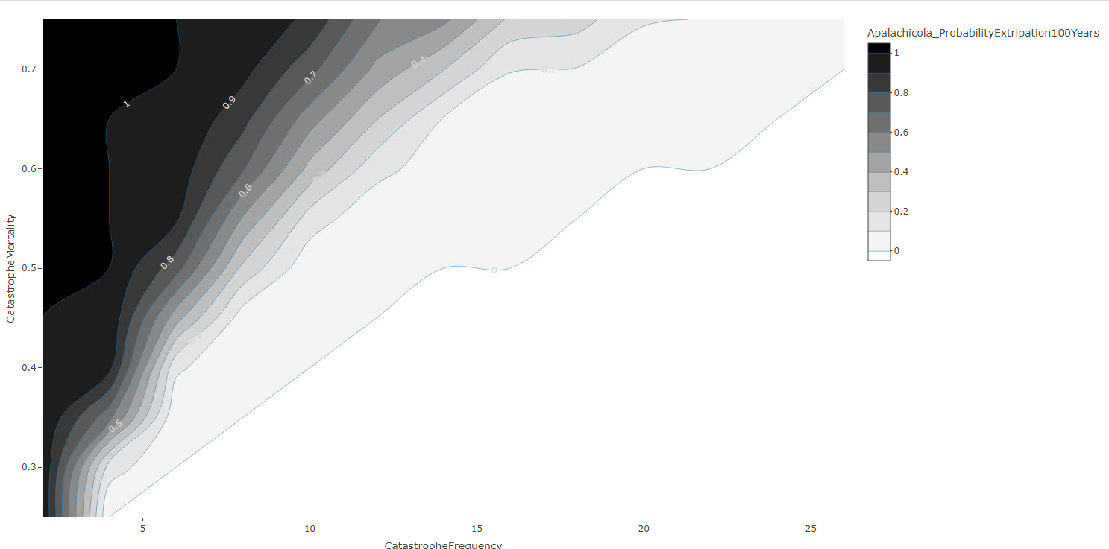
Catastrophe, 200sims, fine grid, non-IBM Recruit

Slide 11
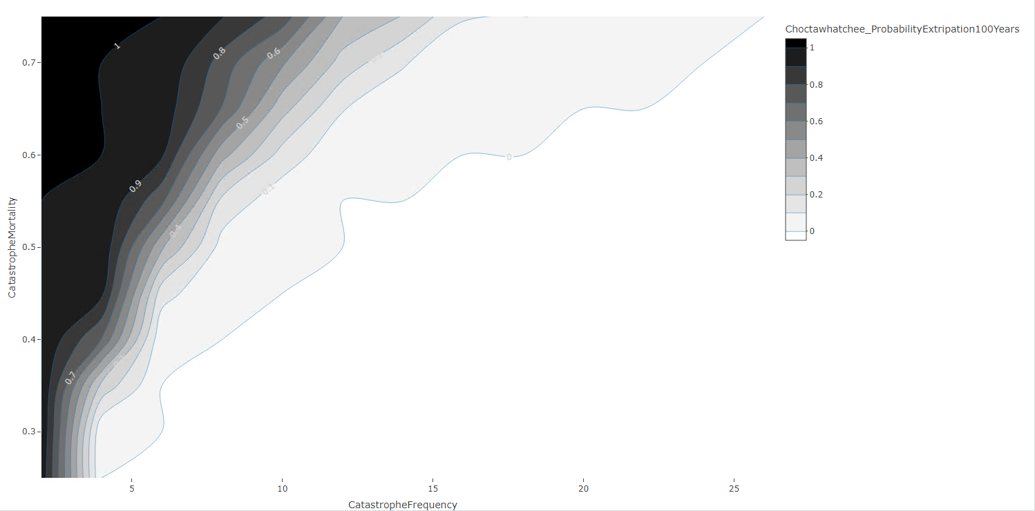
Catastrophe, 200sims, fine grid, non-IBM Recruit

Slide 12
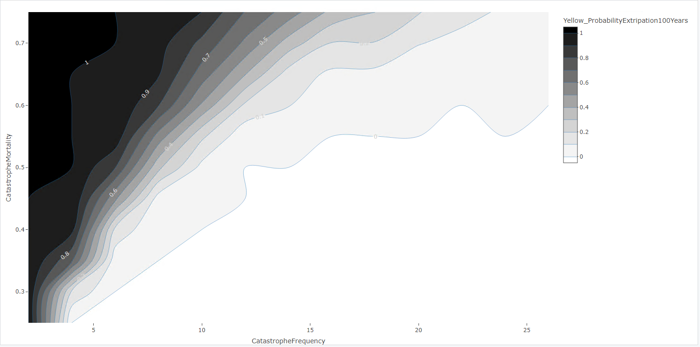
Catastrophe, 200sims, fine grid, non-IBM Recruit

Slide 13
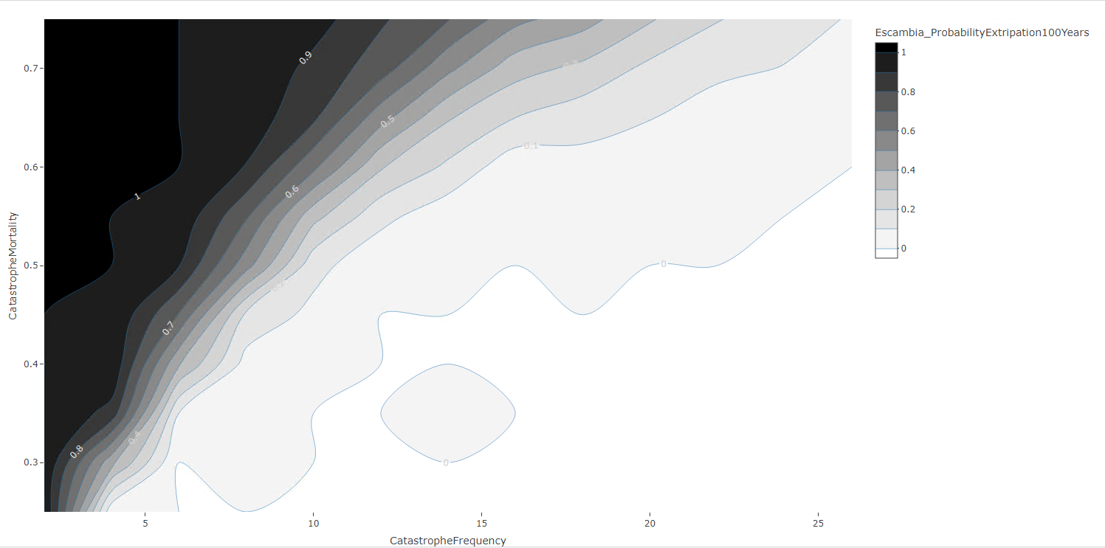
Catastrophe, 200sims, fine grid, non-IBM Recruit

Slide 14
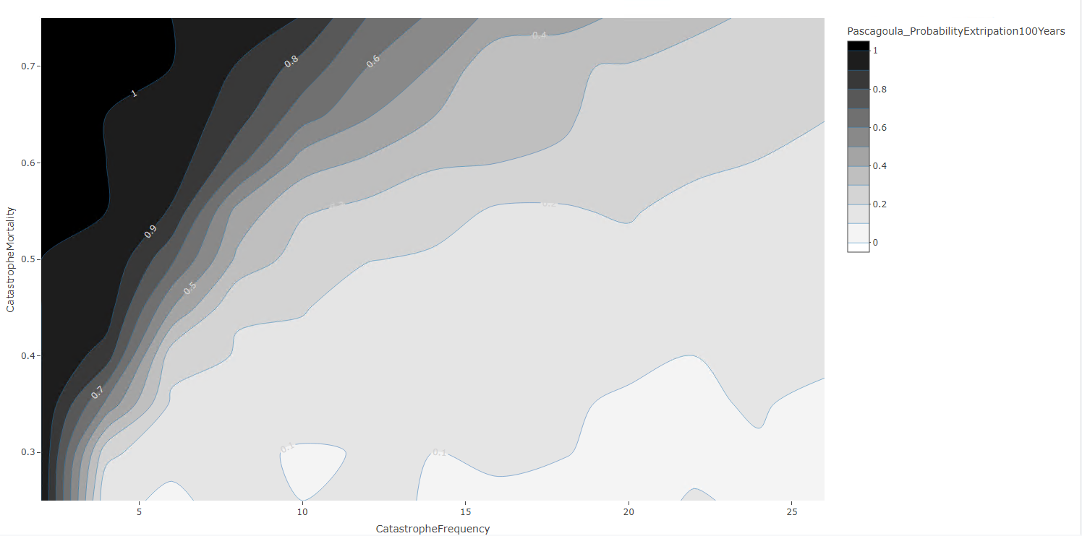
Catastrophe, 200sims, fine grid, non-IBM Recruit

Slide 15
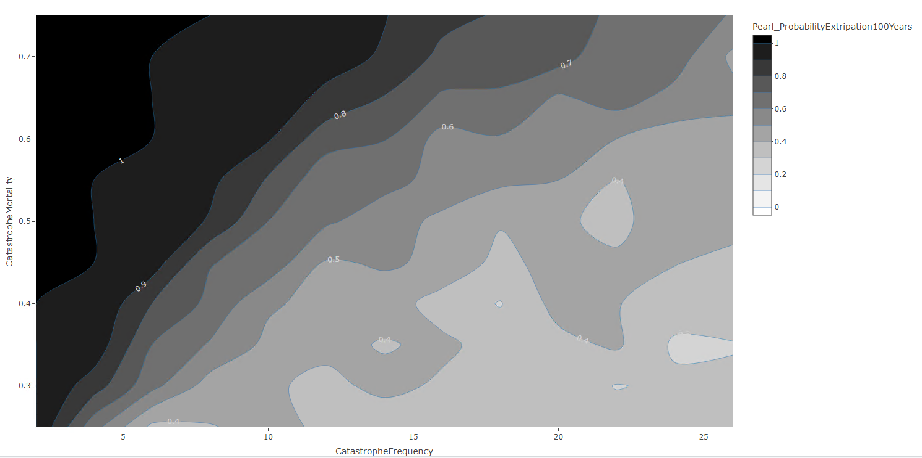
Catastrophe, 200sims, fine grid, non-IBM Recruit

Slide 16
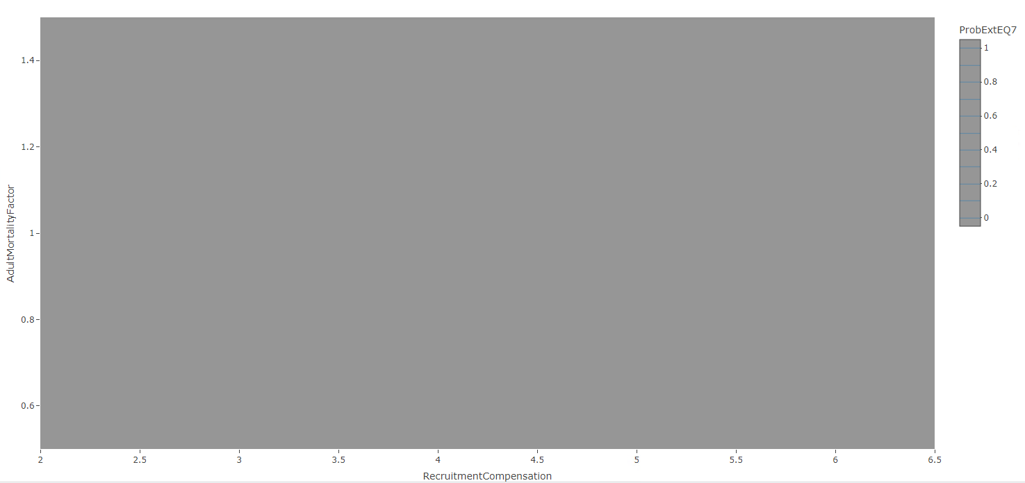
lifehistory, 200sims, fine grid, no catastrophe, non-IBM Recruitment
Probability of Extirpation = 0

Slide 17
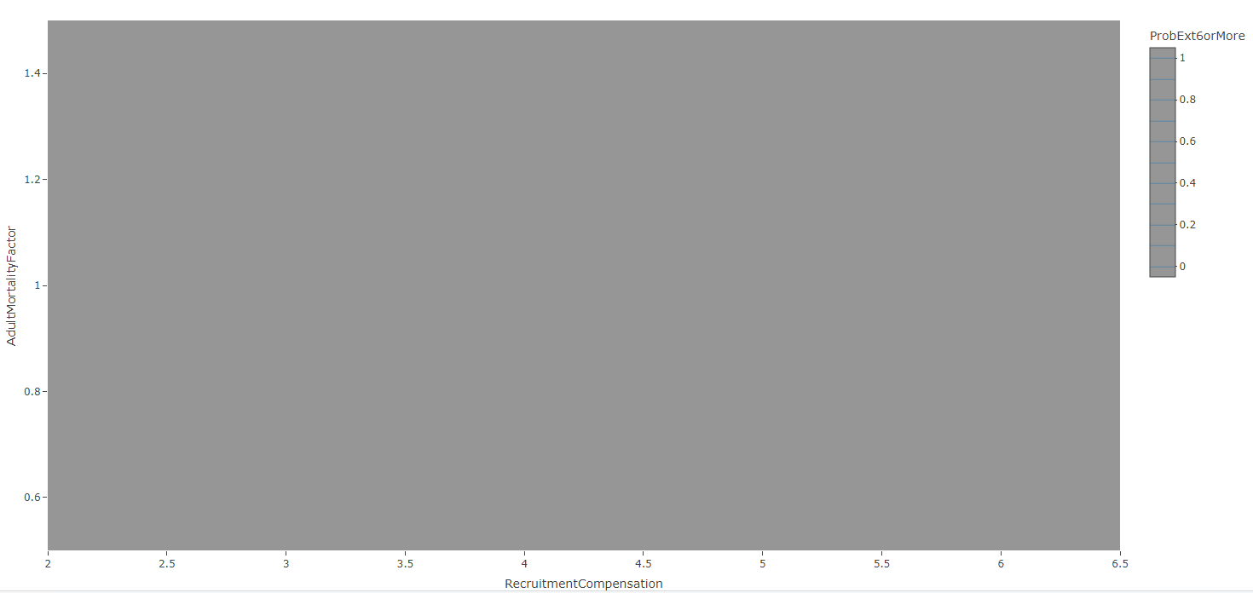
lifehistory, 200sims, fine grid, no catastrophe, non-IBM Recruitment
Probability of Extirpation = 0

Slide 18
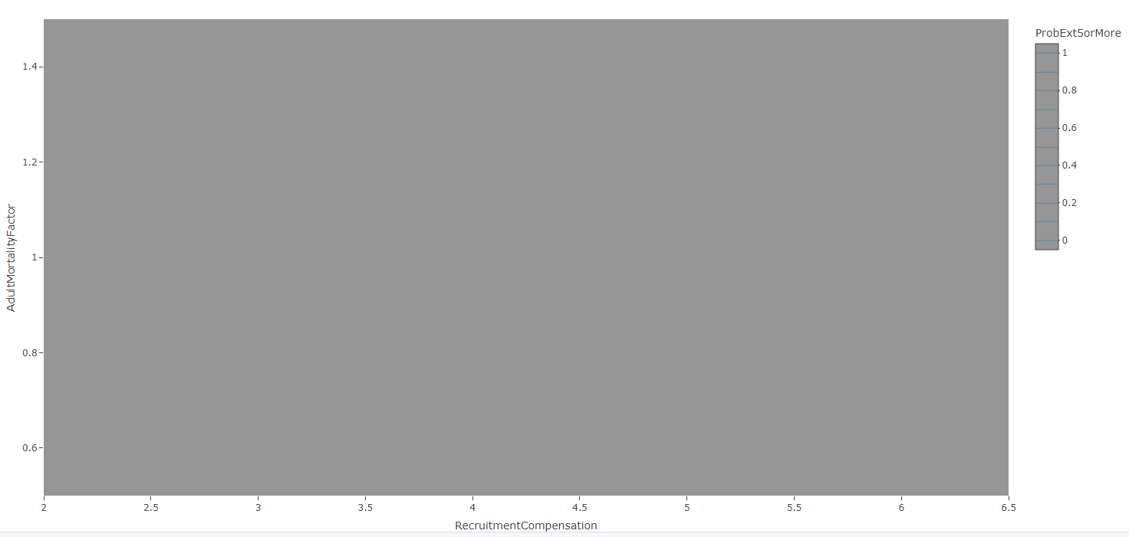
lifehistory, 200sims, fine grid, no catastrophe, non-IBM Recruitment
Probability of Extirpation = 0

Slide 19
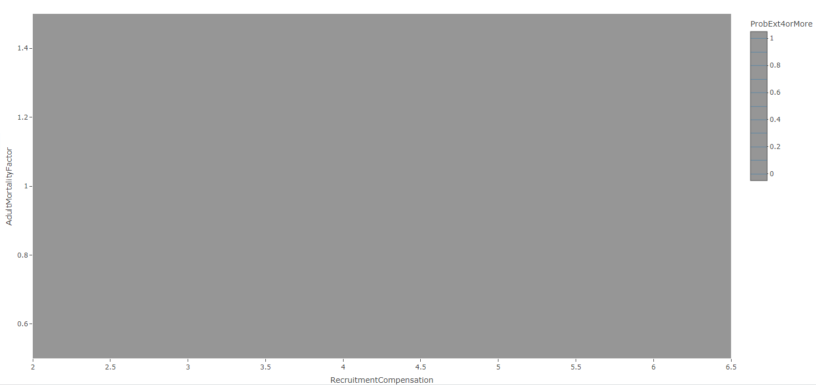
lifehistory, 200sims, fine grid, no catastrophe, non-IBM Recruitment
Probability of Extirpation = 0

Slide 20
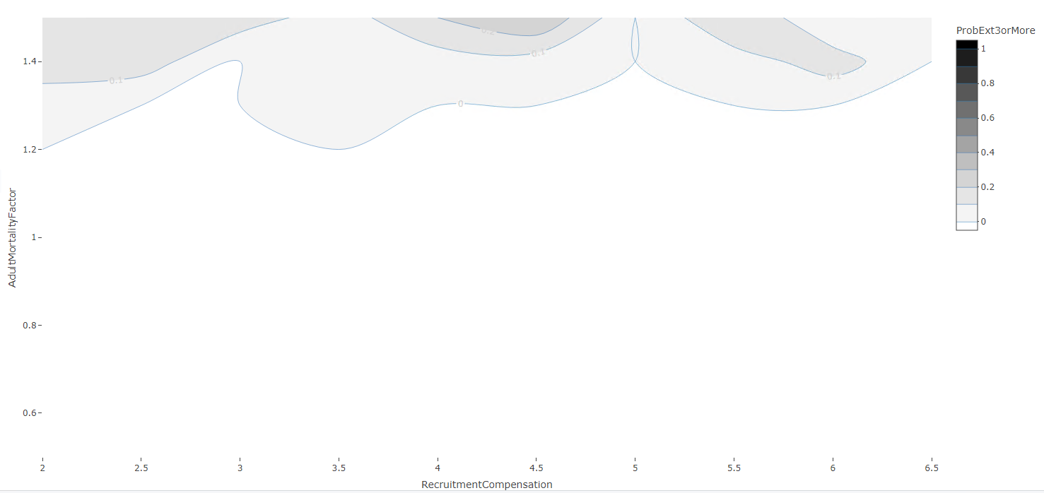
lifehistory, 200sims, fine grid, no catastrophe, non-IBM Recruitment

Slide 21
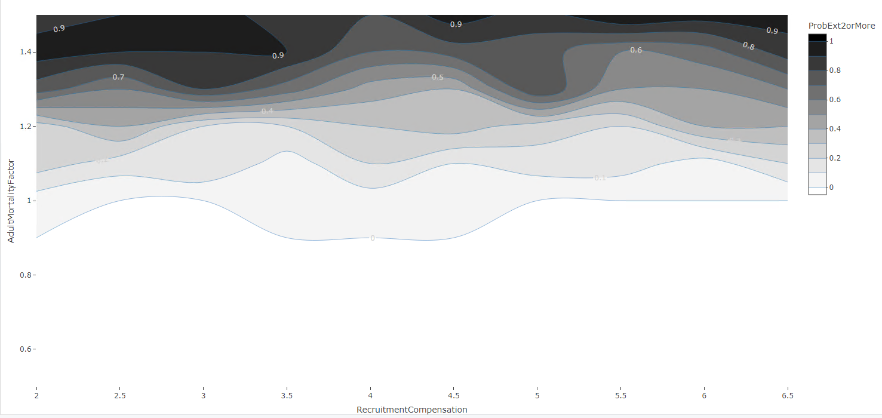
lifehistory, 200sims, fine grid, no catastrophe, non-IBM Recruitment

Slide 22
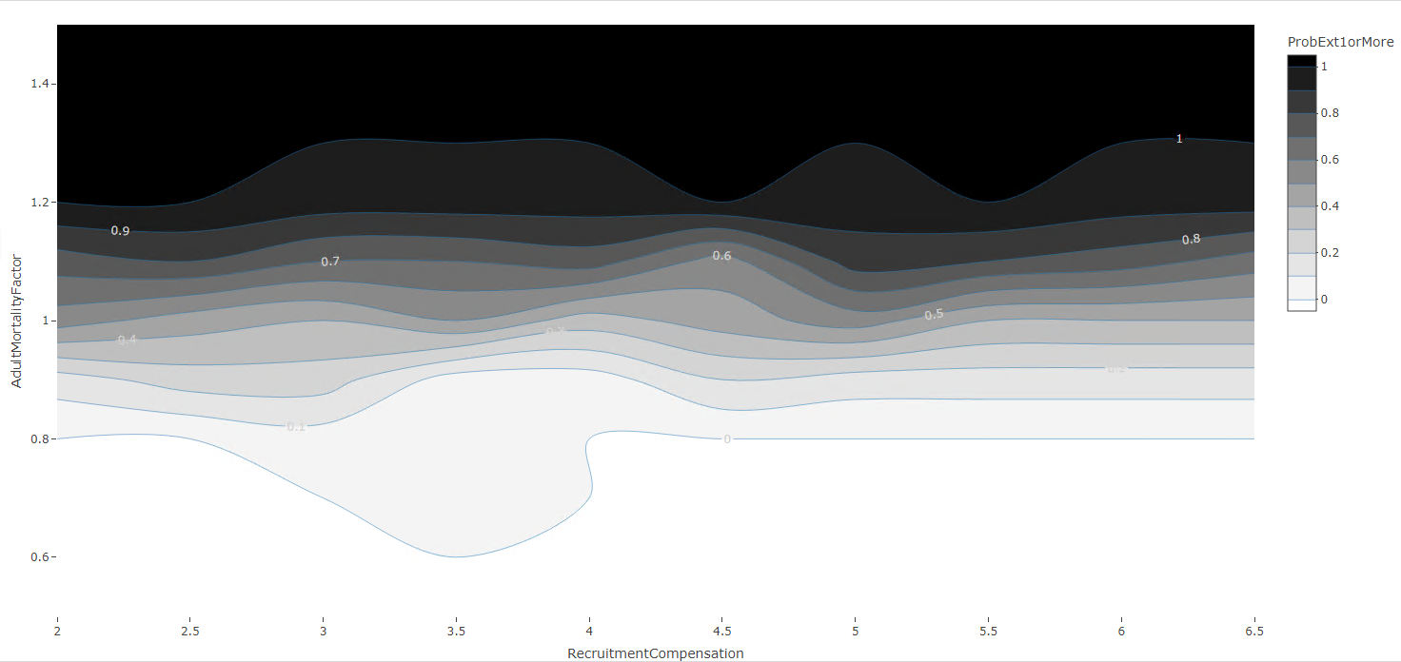
lifehistory, 200sims, fine grid, no catastrophe, non-IBM Recruitment

Slide 23
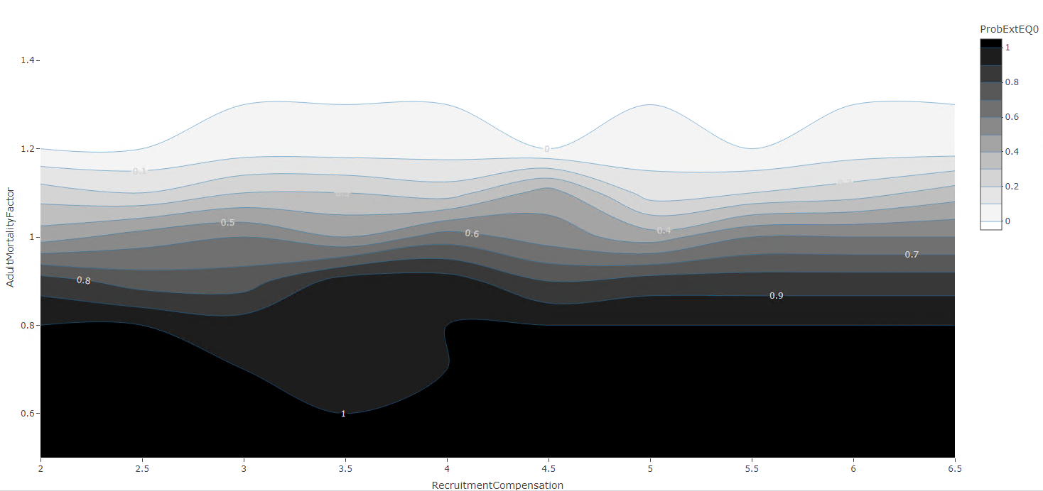
lifehistory, 200sims, fine grid, no catastrophe, non-IBM Recruitment

Slide 24
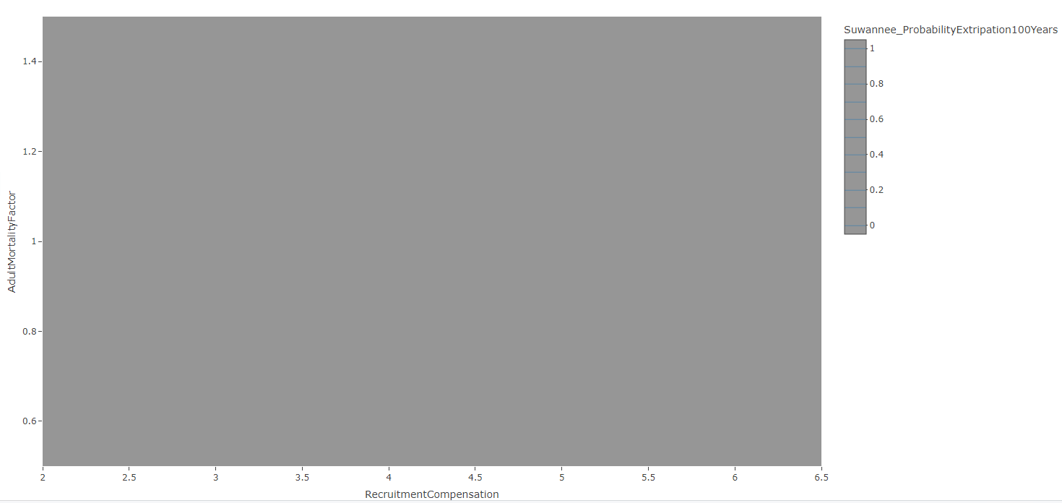
lifehistory, 200sims, fine grid, no catastrophe, non-IBM Recruitment
Probability of Extirpation = 0

Slide 25
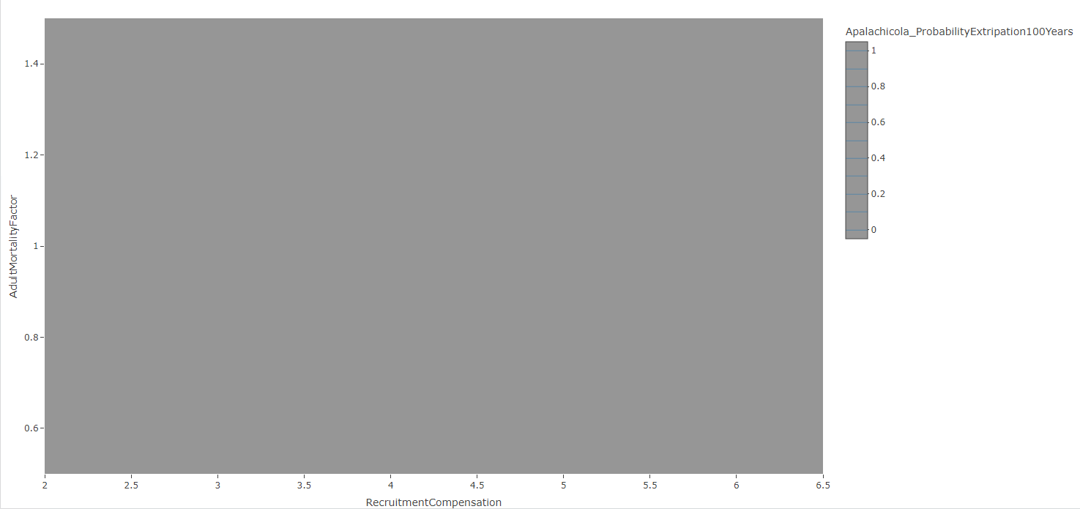
lifehistory, 200sims, fine grid, no catastrophe, non-IBM Recruitment
Probability of Extirpation = 0

Slide 26
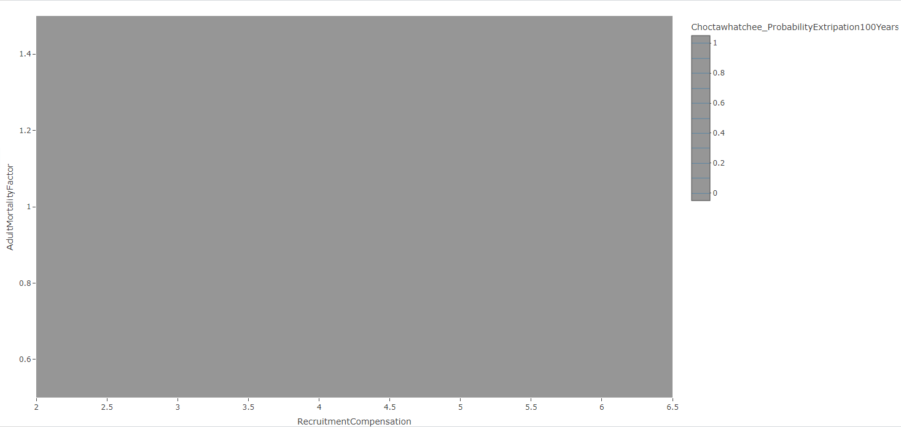
lifehistory, 200sims, fine grid, no catastrophe, non-IBM Recruitment
Probability of Extirpation = 0

Slide 27
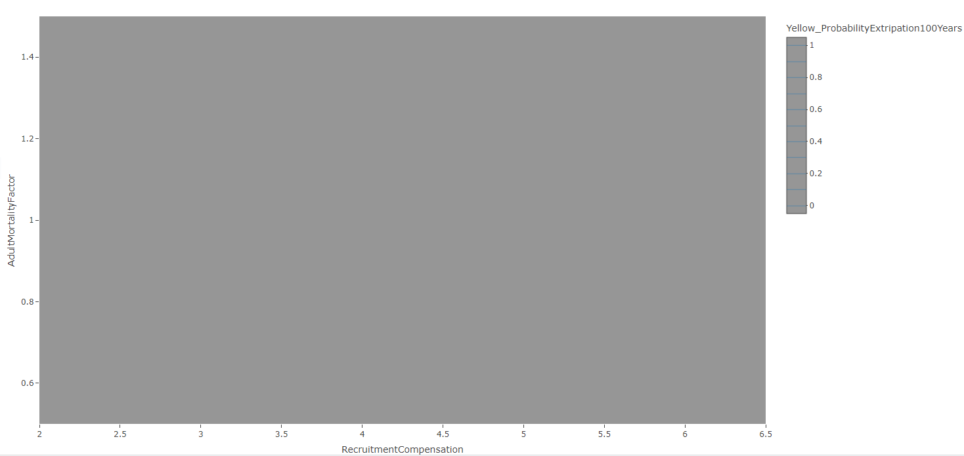
lifehistory, 200sims, fine grid, no catastrophe, non-IBM Recruitment
Probability of Extirpation = 0

Slide 28
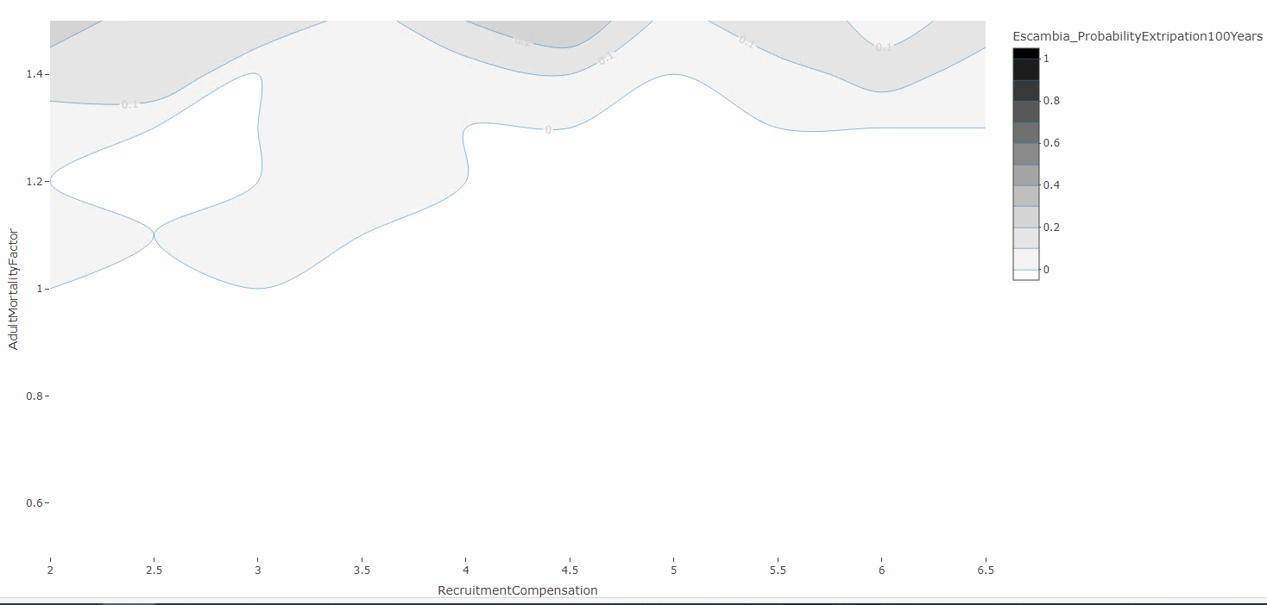
lifehistory, 200sims, fine grid, no catastrophe, non-IBM Recruitment

Slide 29
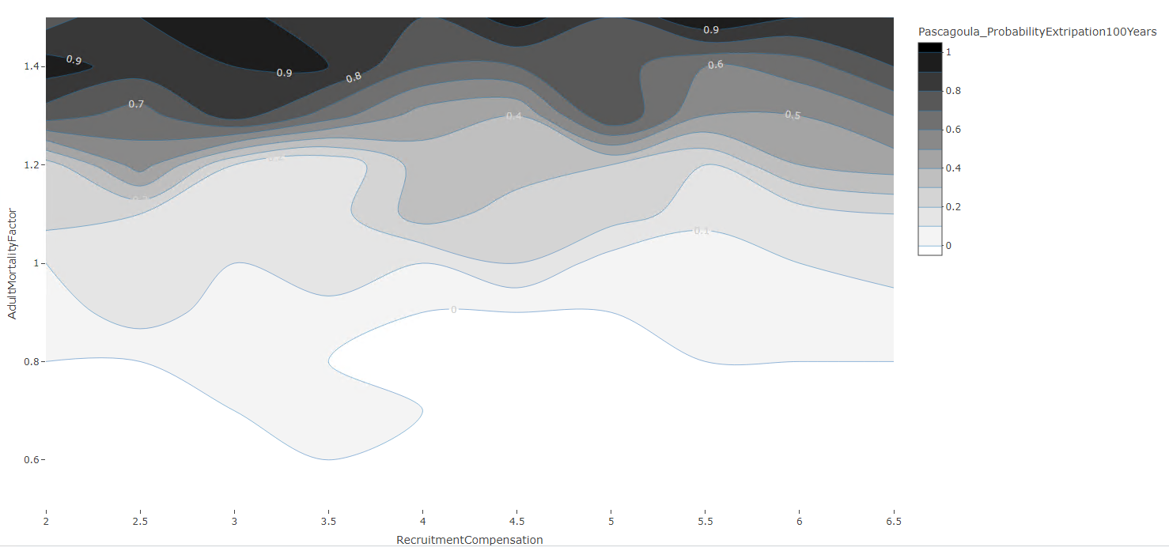
lifehistory, 200sims, fine grid, no catastrophe, non-IBM Recruitment

Slide 30
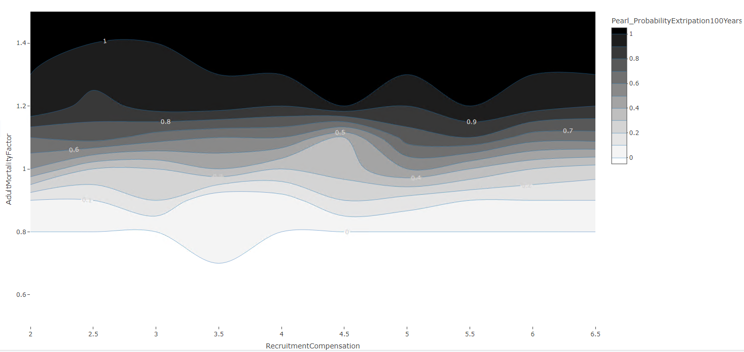
lifehistory, 200sims, fine grid, no catastrophe, non-IBM Recruitment

Slide 31
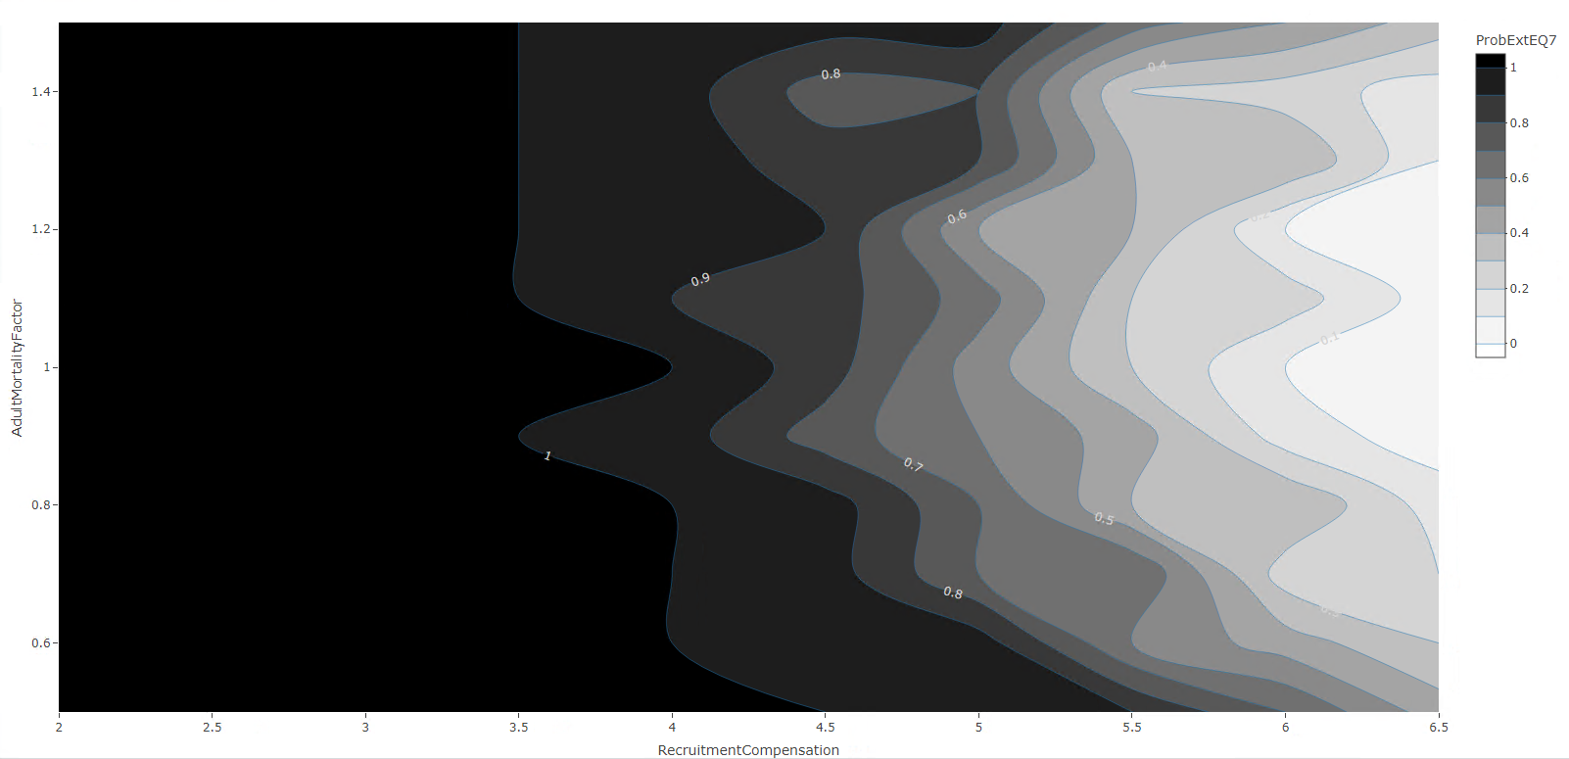
lifehistory, 200sims, fine grid, catFreq=2, CatAM=.3, non-IBM Recruitment

Slide 32
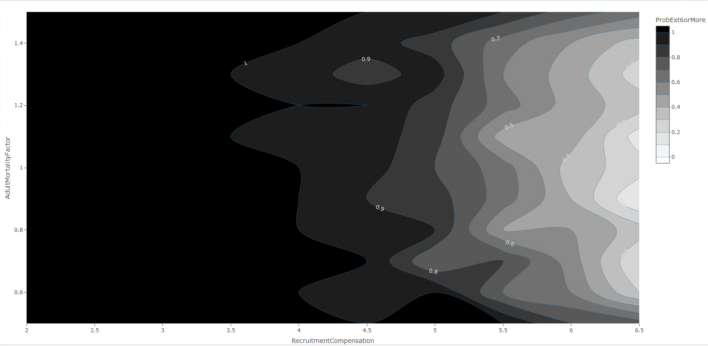
lifehistory, 200sims, fine grid, catFreq=2, CatAM=.3, non-IBM Recruitment

Slide 33
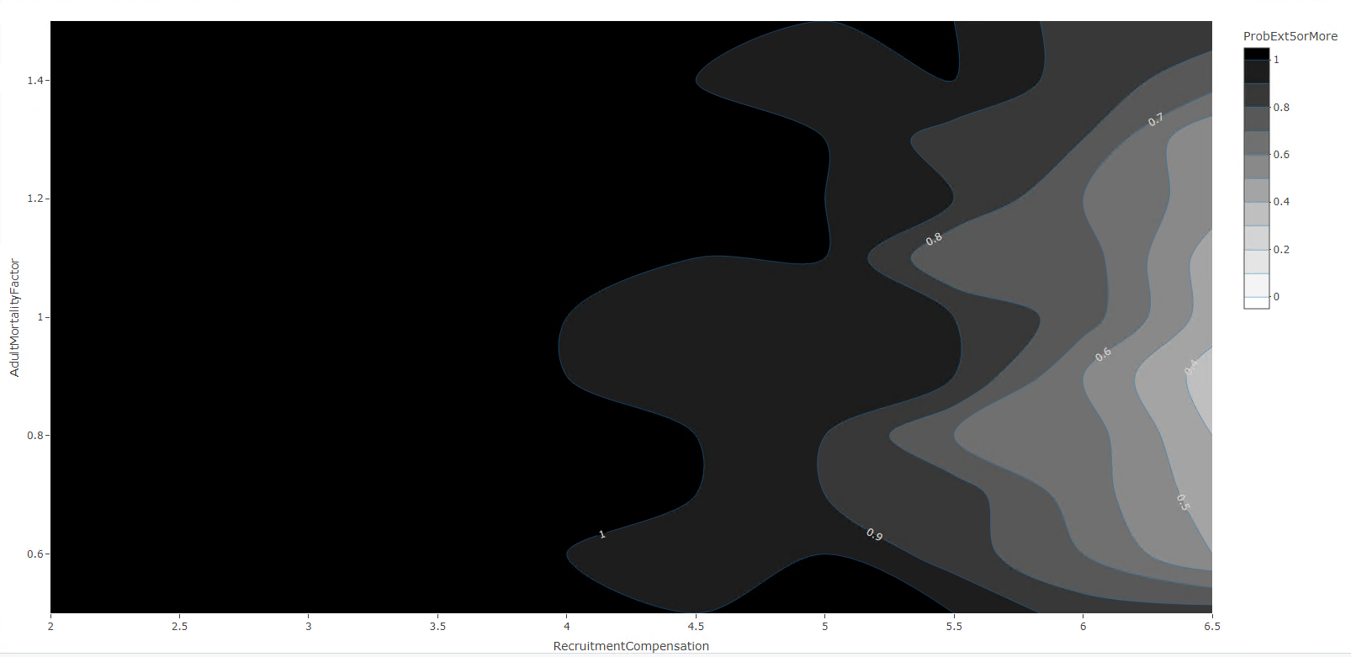
lifehistory, 200sims, fine grid, catFreq=2, CatAM=.3, non-IBM Recruitment

Slide 34
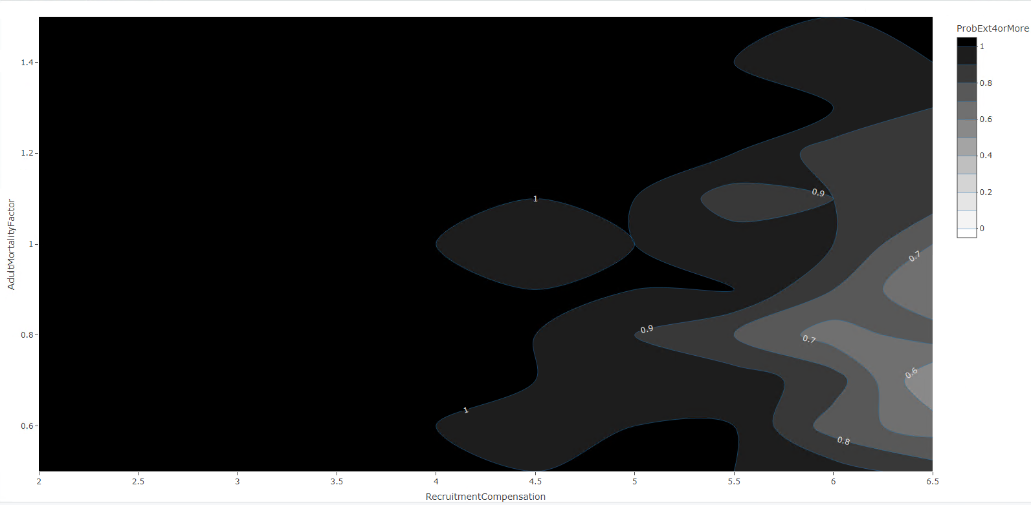
lifehistory, 200sims, fine grid, catFreq=2, CatAM=.3, non-IBM Recruitment

Slide 35
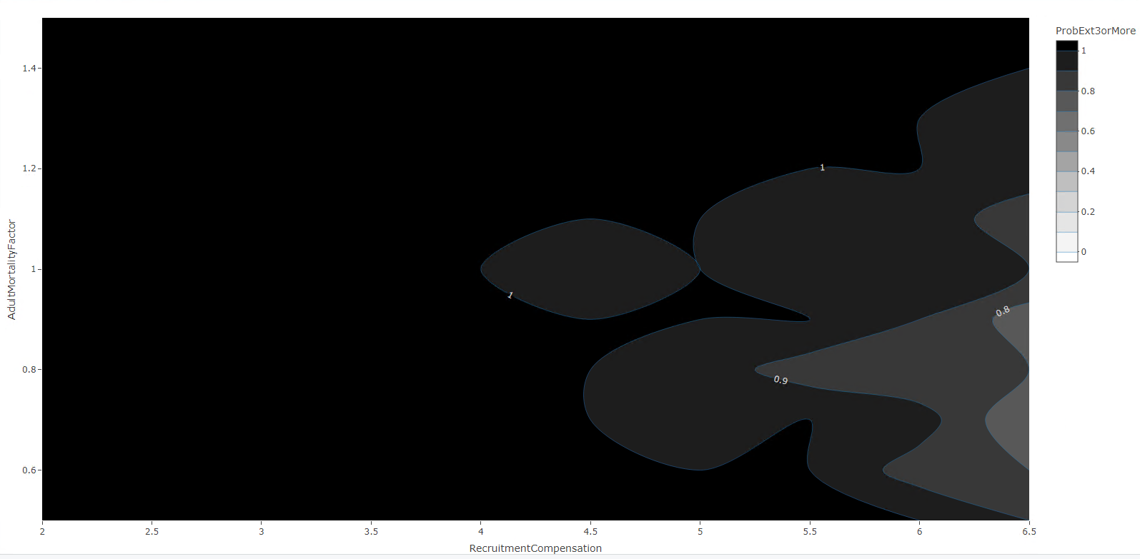
lifehistory, 200sims, fine grid, catFreq=2, CatAM=.3, non-IBM Recruitment

Slide 36
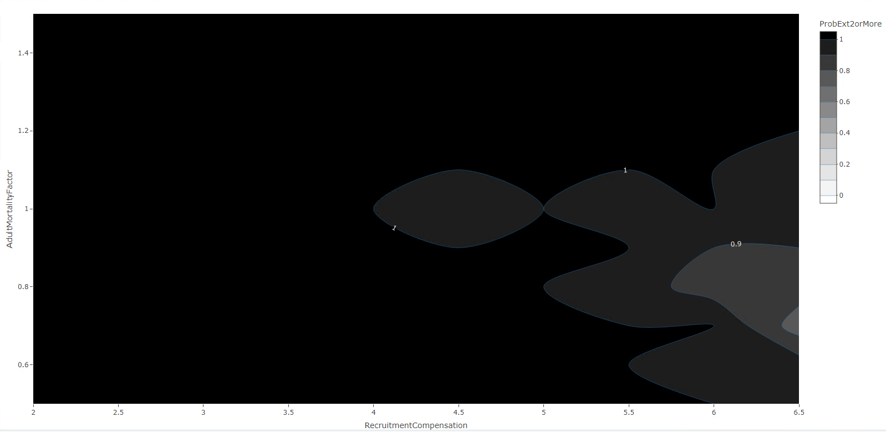
lifehistory, 200sims, fine grid, catFreq=2, CatAM=.3, non-IBM Recruitment

Slide 37
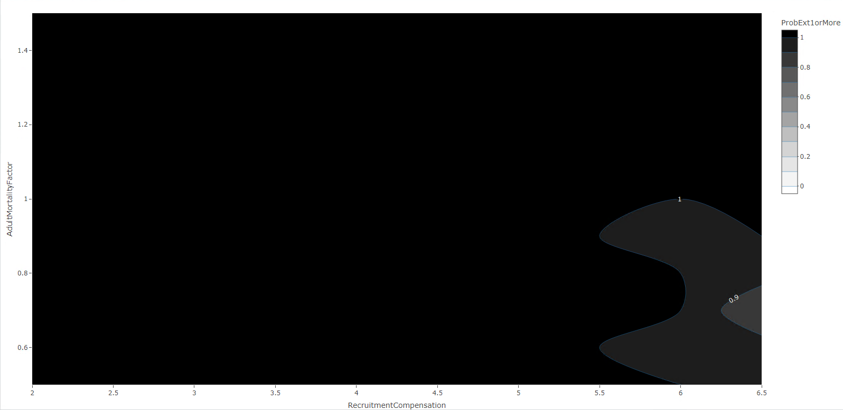
lifehistory, 200sims, fine grid, catFreq=2, CatAM=.3, non-IBM Recruitment

Slide 38
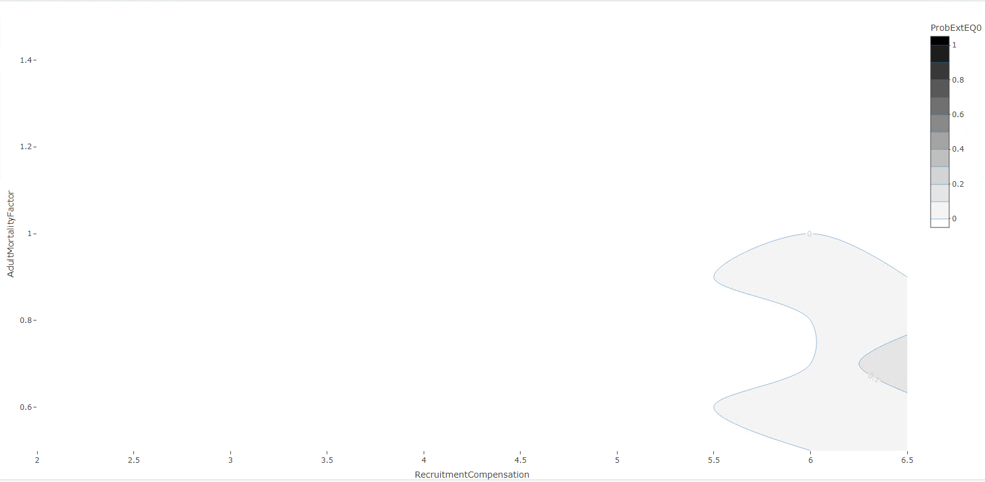
lifehistory, 200sims, fine grid, catFreq=2, CatAM=.3, non-IBM Recruitment

Slide 39
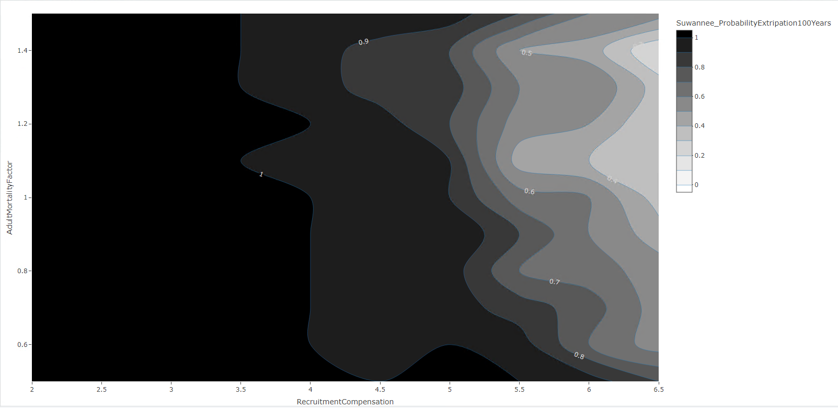
lifehistory, 200sims, fine grid, catFreq=2, CatAM=.3, non-IBM Recruitment

Slide 40
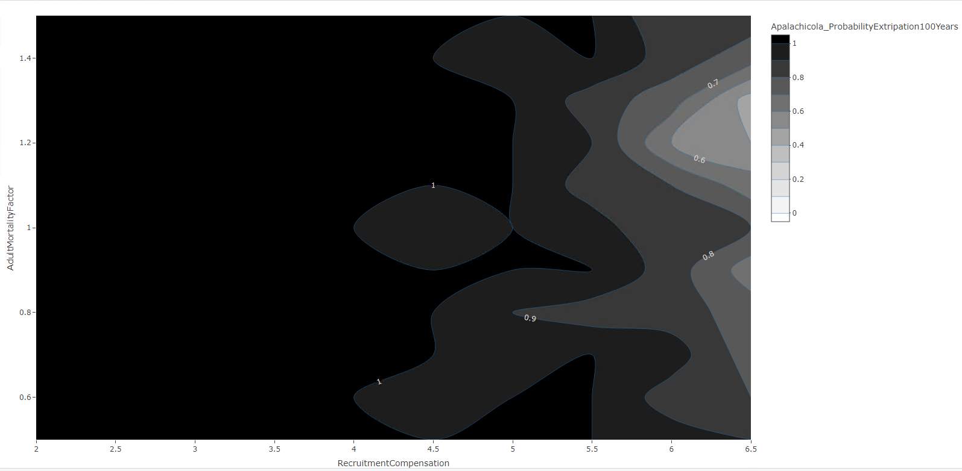
lifehistory, 200sims, fine grid, catFreq=2, CatAM=.3, non-IBM Recruitment

Slide 41
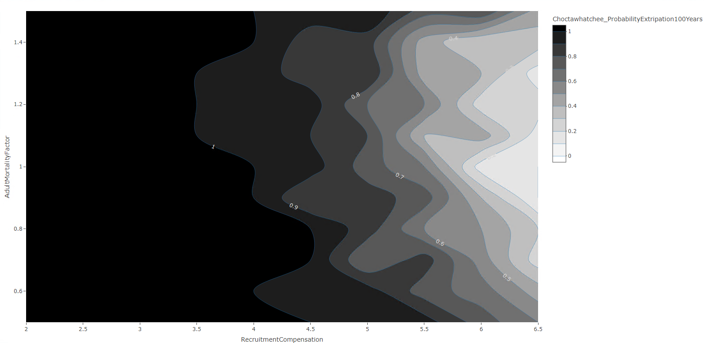
lifehistory, 200sims, fine grid, catFreq=2, CatAM=.3, non-IBM Recruitment

Slide 42
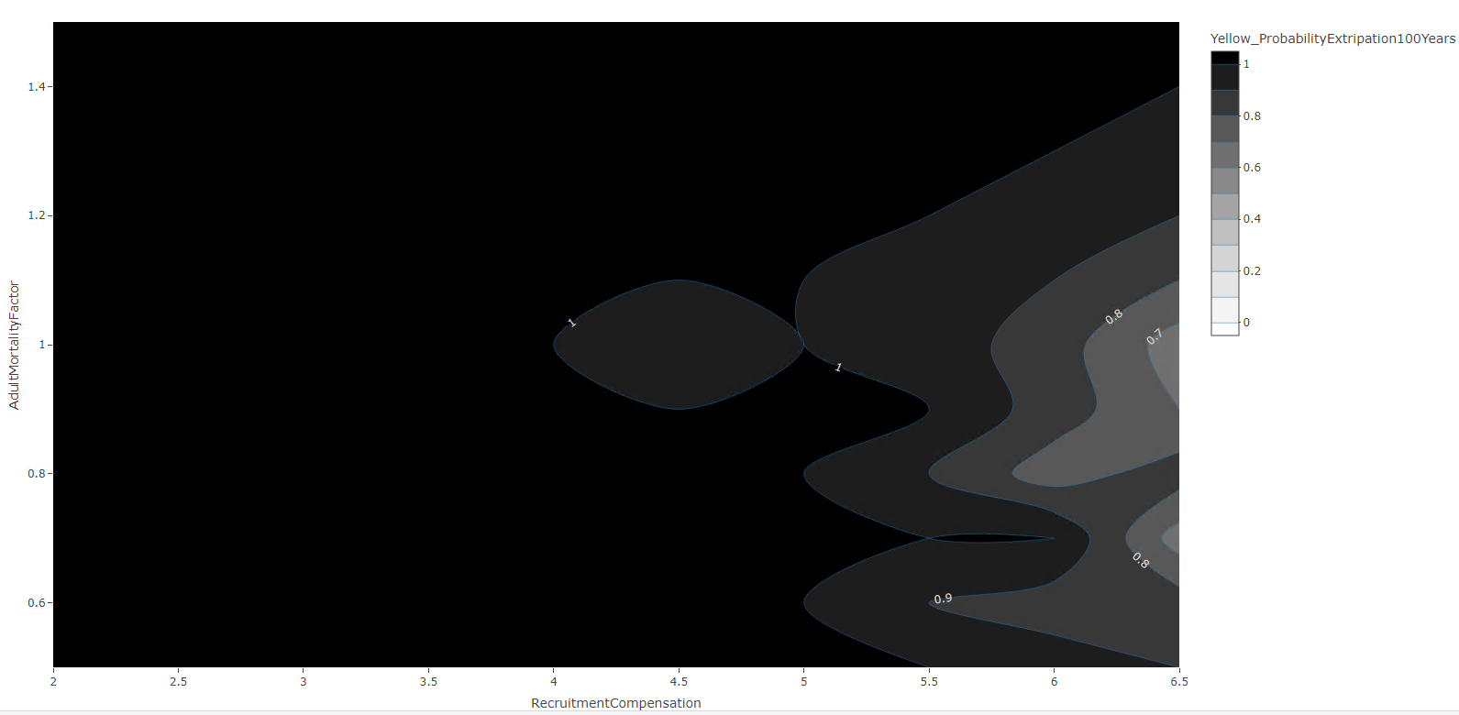
lifehistory, 200sims, fine grid, catFreq=2, CatAM=.3, non-IBM Recruitment

Slide 43
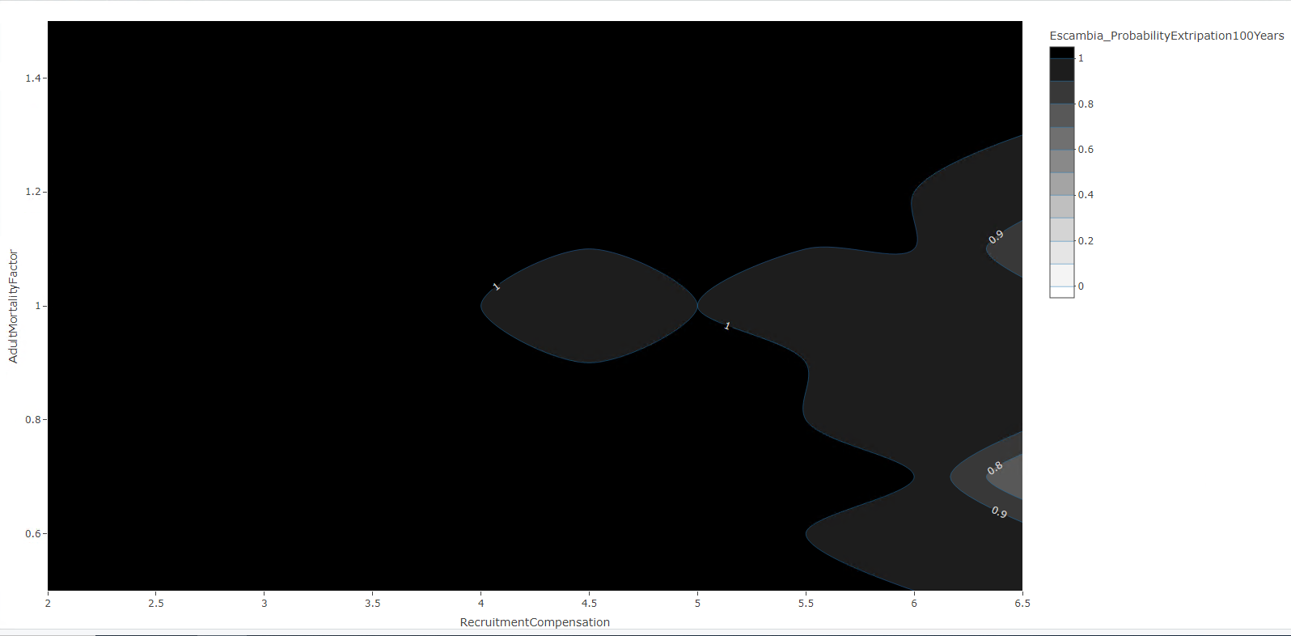
lifehistory, 200sims, fine grid, catFreq=2, CatAM=.3, non-IBM Recruitment

Slide 44
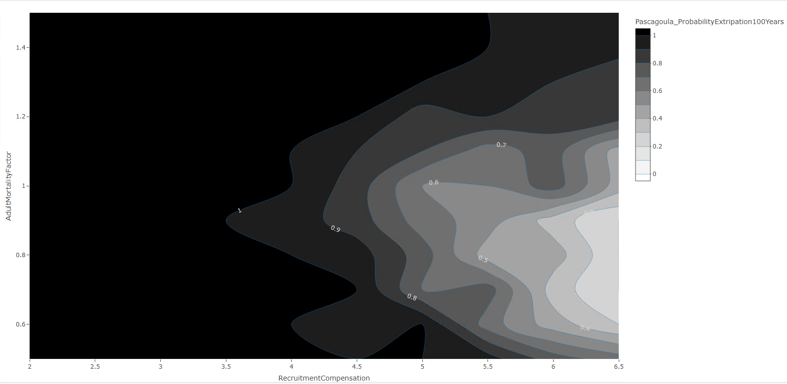
lifehistory, 200sims, fine grid, catFreq=2, CatAM=.3, non-IBM Recruitment

Slide 45
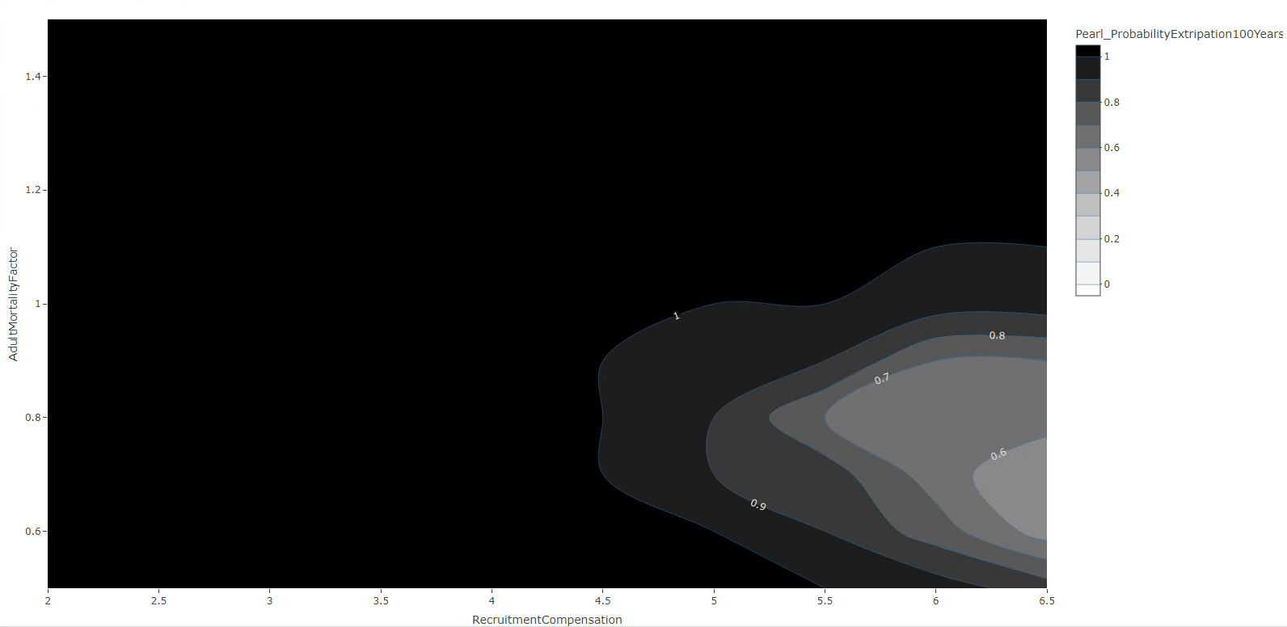
lifehistory, 200sims, fine grid, catFreq=2, CatAM=.3, non-IBM Recruitment

